Slide 1
Harmony in the Society

Slide 2
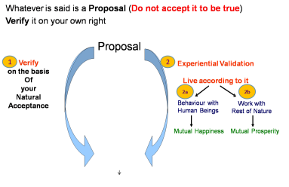
Self-exploration, Self-investigation, Self-study
1. Content of Self Exploration:
  a. Desire (pkguk) - Aim, Purpose
  b. Program (djuk) – Process of achieving the desire, action
Happiness = To be in Harmony
2. Process of Self Exploration
Self-verification
– Happiness, Prosperity → Continuity
To understand Harmony & to live in harmony at all 4 levels:
  Harmony in the Human Being
  Harmony in the Family
  Harmony in the Society
  Harmony in Nature/Existence

Slide 3
Harmony in Society
Goal of Human Being Living in Society (Human Target)
The System Required for the Goal to be Achieved
Scope of this System

Slide 4
What is Desirable and Where are we today?
People living in a relationship of mutual fulfillment
Society
People living together, but not in relationship of mutual fulfillment
Crowd
People living separately, in opposition / struggle
Battlefield

Slide 5
Harmony in the Society (lekt esa O;oLFkk)
Human Target (ekuo y{;)
Are all 4 required, desirable or we can leave something out?
Other than these 4, what else is required?
Are we working for all 4?
Right Understanding & Right Feelings
Prosperity
Fearlessness
(Trust)
Co-Existence
In Every Individual
In Every Family
In Society
In Nature/ Existence

Slide 6
Current State – Have we understood our Goal?
Human Target (ekuo y{;)
Gross Misunderstanding (vk/kkjHkwr Hkze)
Right Understanding & Right Feelings
Prosperity
Fearlessness
(Trust)
Co-Existence
In Every Individual
In Every Family
In Society
In Nature/ Existence
Assumptions (eg. Money is everything)
Accumulation
By Any Means
Domination ,
Exploitation, Fear
Mastery &
Exploitation
In Every Individual
In few Individuals
In Society
Over Nature
Madness for Consumption Hkksx mUekn
Madness for Profit ykHk mUekn
Madness for Sensual Pleasure dke mUekn
Terrorism
War
Resource Depletion
Pollution

Slide 7
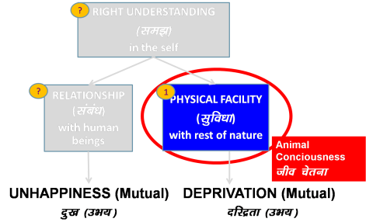
Current State – Society based on Domination & Exploitation
Fragmented Society
Assumptions about Human Target
- Individual
- Society
Gross Misunderstanding
(vk/kkjHkwr Hkze)
Assumptions (eg. Money is everything)
Accumulation
By Any Means
Domination &
Exploitation
Mastery &
Exploitation
In Every Individual
In few Individuals
In Society
Over Nature
Copious Consumption Hkksx mUekn
Madness for Profit ykHk mUekn
Madness for Sensual Pleasure dke mUekn
Terrorism
War
Resource Depletion
Pollution

Slide 8
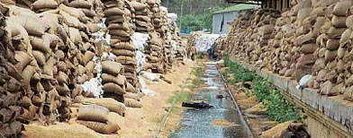
As crops rot, millions go hungry in India – Reuters 2-July-2012
NEW DELHI (Reuters) - Every day some 3,000 Indian children die from illnesses related to malnutrition, and yet countless heaps of rodent-infested wheat and rice are rotting in fields across the north of their own country.
It is an extraordinary paradox created by a rigid regime of subsidies for grain farmers, a woeful lack of storage facilities and an inefficient, corruption-plagued public distribution system that fails millions of impoverished people.
http://in.news.yahoo.com/crops-rot-millions-hungry-india-031352121--finance.html

Slide 9
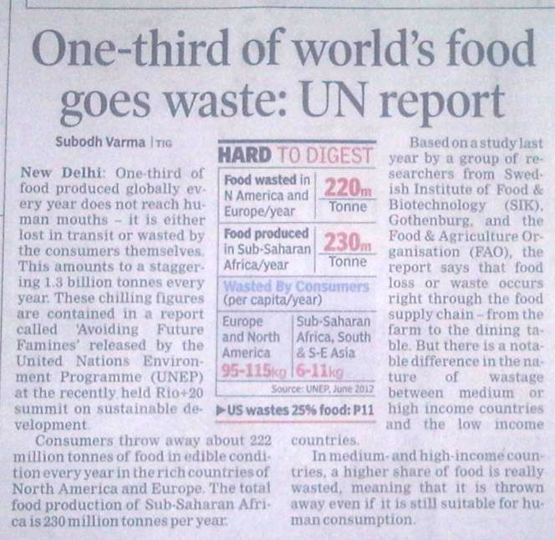
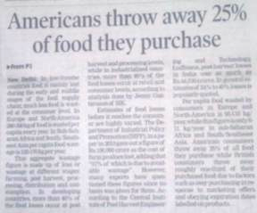
Times of India – 28-June-2012

Slide 10
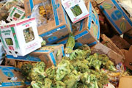
FAO Report – 11-May-2011
More than 1 billion tons of food lost or wasted every year, UN-backed report finds (11 May 2011)
About a third of all the food produced for human consumption each year – or roughly 1.3 billion tons – is lost or wasted, according to a new study commissioned by the United Nations Food and Agriculture Organization (FAO)
Global Food Production is 6 times requirement
Global Food Wastage is 1/3rd of production
Wastage is enough to feed 1300 crore people/year
Have we understood right utilisation?
Is it a question of production?
Is it a question of relationship?
Is it a question of right understanding?
http://www.un.org/apps/news/story.asp?NewsID=38344&Cr=fao&Cr1

Slide 11
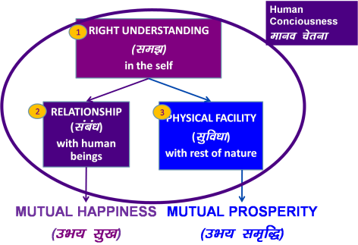
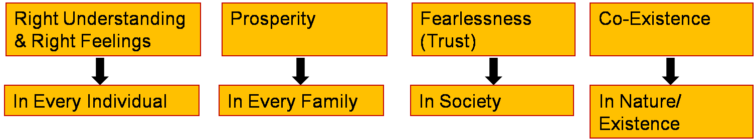
Desired State – Humane Society that fulfills Human Goals
Human Target – As an Individual
1. Living in Bondage (Sorrow) X
2. Salvation from Bondage √
3. Living with Continuous Happiness
or Swatantrata √
Human Target – As a Family
1. Justice
2. Prosperity
3. Participate in Human Society
Human Target – As a Society
Integrated Society

Slide 12
Domination (shasan) Self Organization (vyavastha)
Every unit is selfish. Individual aims are dissonant with others & with collective
Central control. Fear, incentive, faith used to motivate
Power, energy is centralized. Externally, centrally regulated
Top down
Human being is a resource
Every unit is self organized. Individual aims are complementary to others & to collective
No central control. Each unit is responsible, self motivated
Every unit is self energized & self regulated
Bottom up
Human being is co-existence of Self(I) & Body
Body is a resource of the Self(I)

Slide 13
Harmony in the Society (lekt esa O;oLFkk)
Human Target (ekuo y{;)
Human Order ¼ekuoh; O;oLFkk½
Five Dimensions ¼i¡kp vk;ke½
  1. Education – Sanskar - f”k{kk laLdkj
  2. Health – Sanyam - LokLF; la;e
  3. Production – Work - mRiknu dk;Z
  4. Justice – Suraksha - U;k; lqj{kk
  5. Exchange – Storage - fofue; dks’k
Right Understanding & Right Feelings
Prosperity
Fearlessness
(Trust)
Co-Existence
In Every Individual
In Every Family
In Society
In Nature/ Existence
1
2
3
4

Slide 14
Harmony in the Society (lekt esa O;oLFkk)
Human Target (ekuo y{;)
Human Order ¼ekuoh; O;oLFkk½
Five Dimensions ¼i¡kp vk;ke½
  1. Education – Sanskar
  2. Health – Sanyam
  3. Production – Work
  4. Justice – Suraksha
  5. Exchange – Storage
Right Understanding & Right Feelings
Prosperity
Fearlessness
(Trust)
Co-Existence
1
2
3
4
In Every Individual
In Every Family
In Society
In Nature/ Existence
1
2
3
4
1
2
4
3
4
2
3

Slide 15
Harmony in the Society (lekt esa O;oLFkk)
Human Target
Human Order ¼ekuoh; O;oLFkk½
Five Dimensions ¼i¡kp vk;ke½
  1. Education – Sanskar
  2. Health – Sanyam
  3. Production – Work
  4. Justice – Suraksha
  5. Exchange – Storage
Right Understanding & Right Feelings
Prosperity
Fearlessness
(Trust)
Co-Existence
1
In Every Individual
In Every Family
In Society
In Nature/ Existence
1
2
3
4
1a. Education – To develop the right understanding of the harmony at all levels of our living – from self to the entire existence (individual, family, society, nature/existence)
1b. Sanskar – The commitment, preparation and practice of living in harmony. Preparation includes learning the skills and technology for living in harmony at all levels – from self to the entire existence (individual, family, society, nature/existence)
1

Slide 16
Harmony in the Society (lekt esa O;oLFkk)
Human Target
Human Order ¼ekuoh; O;oLFkk½
Five Dimensions ¼i¡kp vk;ke½
  1. Education – Sanskar
  2. Health – Sanyam
  3. Production – Work
  4. Justice – Suraksha
  5. Exchange – Storage
Right Understanding & Right Feelings
Prosperity
Fearlessness
(Trust)
Co-Existence
2
4
In Every Individual
In Every Family
In Society
In Nature/ Existence
1
2
3
4
2b. Sanyam – Feeling of responsibility for Nurturing, Protection and Right Utilization of the Body
2a. Health (Swasthya) –
  Body acts according to I
  Parts of the body are in harmony (in order)
→ Recognising What is Needed
2
4

Slide 17
Program for Health (Swasthya)
Sanyam in the Self (I): Feeling of responsibility for Nurturing, Protection and Right Utilization of the Body
Health (Swasthya) in the Body
  1. Body acts according to Self (I)
  2. Parts of the body are in harmony (in order)
Program for Sanyam
  1a. Intake 1b. Daily Routine for upkeep
  2a. Labour 2b. Exercise
  3a. Asan 3b. Pranayam (Breathing)
  4a. Medicine 4b. Treatment
Intake includes air, water, food (poshak, pachak, nishkashak)
Vihar includes daily routine
Shram done on rest of nature that results in produce

Slide 18
Harmony in the Society (lekt esa O;oLFkk)
Human Target
Human Order ¼ekuoh; O;oLFkk½
Five Dimensions ¼i¡kp vk;ke½
  1. Education – Sanskar
  2. Health – Sanyam
  3. Production – Work
  4. Justice – Suraksha
  5. Exchange – Storage
Right Understanding & Right Feelings
Prosperity
Fearlessness
(Trust)
Co-Existence
2
4
In Every Individual
In Every Family
In Society
In Nature/ Existence
1
2
3
4
2
4
3b. Work: The labour a human being does on the rest of nature
3a. Production: The physical facility obtained out of work

Slide 19
Harmony in the Society (lekt esa O;oLFkk)
Human Target
Human Order ¼ekuoh; O;oLFkk½
Five Dimensions ¼i¡kp vk;ke½
  1. Education – Sanskar
  2. Health – Sanyam
  3. Production – Work
  4. Justice – Suraksha
  5. Exchange – Storage
Right Understanding & Right Feelings
Prosperity
Fearlessness
(Trust)
Co-Existence
2
4
In Every Individual
In Every Family
In Society
In Nature/ Existence
1
2
3
4
1. What to Produce?
Required Physical Facility (necessary for nurturing, Protection & right utilisation of body)
2
4
2. How to Produce?
Avartansheel Process (Eco-Friendly)
Ensuring Justice (People-Friendly)

Slide 20
Avartansheel Process
Cyclic
Every Unit in the Process is Enriched
Plants
Soil, Water,
Air

Slide 21
Resource Depletion & Pollution
Resource Depletion – The resource is used at a rate which is faster than the rate at which it is produced in Nature
lalk/ku vHkko & mRiknu esa iz;qDr laalk/ku dh xfr] mlds izd`fr esa iSnk gksus dh xfr ls T;knk gS
Pollution – The product is such that
  It does not return to the cycle in Nature or
  It is produced at a rate that is faster than the rate at which it can return to the cycle in Nature
iznw’k.k & mRiknu ,slk gS fd
  1- mRikfnr oLrq pØ esa okil ugha vkrh ;k
  2- mldh xfr izkd`frd pØz esa okil tkus dh xfr T;knk gS

Slide 22
Avartansheel Process
Cyclic
Every Unit in the Process is Enriched
Plants
Soil, Water,
Air
Animals & Birds
?
?
√
?
√
√
Human
Beings

Slide 23
Localise Lons'kh Globalise lkoZHkkSfed
Physical Facility (Intake, Clothes, House…)
lqfo/kk ¼vkgkj] diM+k] vkokl--- ½
Needs of the Body
“kjhj dh vko';drk,a
Right Understanding & Right Feeling
Mindset – of living in a relationship of mutual fulfillment, globally
lgh le>] lgh Hkko ¼Kku] lek/kku½
Needs of the Self (I)
eSa dh vko';drk,a

Slide 24
Harmony in the Society (lekt esa O;oLFkk)
Human Target
Human Order ¼ekuoh; O;oLFkk½
Five Dimensions ¼i¡kp vk;ke½
  1. Education – Sanskar
  2. Health – Sanyam
  3. Production – Work
  4. Justice – Suraksha
  5. Exchange – Storage
Right Understanding & Right Feelings
Prosperity
Fearlessness
(Trust)
Co-Existence
3
In Every Individual
In Every Family
In Society
In Nature/ Existence
1
2
3
4
4a. Justice – Recognition of Human-Human Relationship, its Fulfillment & Evaluation leading to Mutual Happiness
3
Notes:
* U;k; lqj{kk& f}rh; egRoiw.kZ vk;ke
U;k;¾ekuo&ekuo laca/k dh igpku] fuokZg]mHk; lq[k
lqj{kk¾ekuo&”ks’k izd`fr laca/k dh igpku] fuokZg]mHk; le`f)
U;k; lqj{kk dh ftEesnkjh gj O;fDr dh gS] ifjokj dh gS] lekt dh gS vkSj varr% jkT; dh gSA
lekt o jkT; esa U;k; lqj{kk dks lqfuf”pr djus dh ftEesnkjh “kklu&iz”kklu dh gSA
jkT; esa vxj U;k;] lqj{kk dh lqfuf”prrk u gks ik;] vogsyuk gks] foijhr gks rks
ml vU;k;] vlqj{kk dks jksdus dh ftEesnkjh U;k;ikfydk o iqfyl dh gSA
U;k; lqj{kk dks lqfuf”pr djus esa “kklu&iz”kklu dk lg;ksx djus dh ftEesnkjh iqfyl dh gSA
U;k; D;k gS\&bls le>uk vko”;d gSA&laca/k] Hkko ewY;&fo”okl] lEeku
lqj{kk D;k gS\ &ijLijiwjdrk
D;k gesa U;k; dh Li’Vrk gS\
D;k ge U;k;iwoZd th jgs gS &Lo;a esa lgh Hkko gS
ifjokj esa lgh Hkko gS] mldk fuokZg dj mHk; lq[k gks jgk gS
fe=ksa esa] lgdfeZ;ksa esa lgh Hkko gS] mldk fuokZg dj mHk; lq[k gks jgk gS
&lekt esa U;k;iwoZd th ik jgs gSa\
&lekt esa vU;k; dks jksd ik jgs gSa\
;gh lc iz”u lqj{kk dks ysdj Hkh gSaA

Slide 25
Harmony in Family – Justice, From Family to World Family (Undivided Society)
Relationship is – between one self (I₁) and other self (I₂). To have this clarity and acceptance in the self – continuously, unconditionally
There are feelings in relationship – in one self (I₁) for other self (I₂)
These feelings can be recognized – they are definite (9 Feelings). Ensuring these feelings in oneself – continuously, unconditionally
Their fulfilment, evaluation leads to mutual happiness. Expressing right feelings, living with responsibility, unperturbed by the behaviour of the other
Feelings
in relationship:
Justice = Recognition, Fulfillment & Evaluation of Human-Human Relationship, leading to Mutual Happiness
Justice → from Family to World Family → Undivided Society ¼v[k.M lekt½
1- Trust fo”okl FOUNDATION VALUE
2- Respect lEeku
3- Affection Lusg
4- Care eerk
5- Guidance okRlY;
6- Reverence J)k
7- Glory xkSjo
8- Gratitude —rKrk
9- Love izse COMPLETE VALUE

Slide 26
Harmony in the Society (lekt esa O;oLFkk)
Human Target
Human Order ¼ekuoh; O;oLFkk½
Five Dimensions ¼i¡kp vk;ke½
  1. Education – Sanskar
  2. Health – Sanyam
  3. Production – Work
  4. Justice – Suraksha
  5. Exchange – Storage
Right Understanding & Right Feelings
Prosperity
Fearlessness
(Trust)
Co-Existence
4
In Every Individual
In Every Family
In Society
In Nature/ Existence
1
2
3
4
4b. Suraksha – Recognition of Human-Rest of Nature Relationship, its Fulfillment & Evaluation leading to Mutual Prosperity or Mutual Enrichment
Prosperity of Human Being
Suraksha of rest of Nature (Enrichment, Protection & Right Utilisation of Nature)
4

Slide 27
Suraksha of rest of Nature
Enrichment, Protection & Right Utilisation of Nature
What is fundamental?
– Right Utilisation of Nature (regardless of where you live – in village or in city)
Wood of 4 full grown trees is enough for one person's needs from birth to death, including the pyre wood
– How many trees can you plant?
Eg. Prof. Parmeshwara Rao of Emanchally village

Slide 28
Prosperity
Prosperity = Feeling of having more than required physical facility
2 1
  Identification of required physical facility (including the required quantity) – with right understanding
  Ensuring availability/ production of more than required physical facility – with right skills
A prosperous person thinks of right utilisation, nurturing the other
“ deprived “ “ “ accumulation, exploiting “ “

Slide 29
What is Physical Facility used for?
Purposefulness –
Transformation
Right Utilisation – Relationship,
Order
Utilisation – Family
Use – Body
Indulgence – Taste
Over Indulgence
Madness for Indulgence
– Sensual
Pleasure
Á;kstuh;rk & thou tkx`rh
lnqI;ksx & laca/k] O;oLFkk
mi;ksx & ifjokj
miHkksx & 'kjhj
Hkksx & bæh; lq[k
cgqHkksx
vfrHkksx ¼Hkksx mUekn½
KkuiwoZd
With Right Understanding
vKkurko'k
Without Right Understanding

Slide 30
Harmony in the Society (lekt esa O;oLFkk)
Human Target
Human Order ¼ekuoh; O;oLFkk½
Five Dimensions ¼i¡kp vk;ke½
  1. Education – Sanskar
  2. Health – Sanyam
  3. Production – Work
  4. Justice – Suraksha
  5. Exchange – Storage
Right Understanding & Right Feelings
Prosperity
Fearlessness
(Trust)
Co-Existence
2
3
In Every Individual
In Every Family
In Society
In Nature/ Existence
1
2
3
4
5a. Exchange – of physical facility with a view of mutual fulfillment (not with madness of profit / of exploitation)
5b. Storage – of physical facility with a view of mutual fulfillment (not with madness of profit / of accumulation)
2
3

Slide 31
Harmony in the Society (lekt esa O;oLFkk)
Human Target (ekuo y{;)
Human Order ¼ekuoh; O;oLFkk½
Five Dimensions ¼i¡kp vk;ke½
  1. Education – Sanskar
  2. Health – Sanyam
  3. Production – Work
  4. Justice – Suraksha
  5. Exchange – Storage
Right Understanding & Right Feelings
Prosperity
Fearlessness
(Trust)
Co-Existence
1
2
3
4
In Every Individual
In Every Family
In Society
In Nature/ Existence
1
2
3
4
1
2
4
3
4
2
3

Slide 32
Harmony in Society – Universal Human Order
Human Target (ekuo y{;)
Five Dimensions of Human Order ¼ekuoh; O;oLFkk & i¡kp vk;ke½
  1. Education – Sanskar - f”k{kk laLdkj
  2. Health – Sanyam - LokLF; la;e
  3. Production – Work - mRiknu dk;Z
  4. Justice – Suraksha - U;k; lqj{kk
  5. Exchange – Storage - fofue; dks’k
Ten Steps ¼nl lksiku½ – From Family Order to World Family Order
Family – Family cluster – Village – Village cluster ... Nation ... World Family
~10¹ ~10² ~10¹⁰
Right Understanding & Right Feelings
Prosperity
Fearlessness
(Trust)
Co-Existence
In Every Individual
In Every Family
In Society
In Nature/ Existence

Slide 33
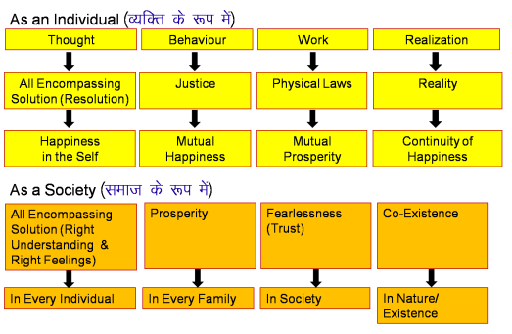
Dynamic Relationship between Individual and Society
Participation
In larger
order
Education
Sanskar,
Environment
As individuals, are we ensuring the fulfillment of the goal at the individual level or are we only expecting fulfillment at the level of society without the fulfillment at the individual level?
The issue is not “this or that”. The issue is “this and that”. We need fulfill the goal at the individual level and fulfill the goal at the society level – both
We need to think of the solution, rather than passing the blame to each other
The solution – first we need to identify the human aspiration. Is there a certain definite human goal at the level of individual, at the level of society – is the goal required or not that is the issue. Then we can talk about it’s fulfillment

Slide 34
Dynamic Relationship between Individual & Family… Society
Sanskar (t), Environment (t), Self-exploration (t) → Sanskar (t+1)
Family environment / tradition = ∑ Sanskar (all family members)
  a) Understanding, Feelings & Thought
  b) Physical Facility
Participation = Understanding goal (individual + family) &
Effort for it's fulfillment
Participation includes effort for getting rid of problems or incompleteness [what’s missing + solution + my role in the solution]
2 key outputs – 1. Own sanskar / understanding & realisation
2. Environment / tradition at level of family… society
1. Education-sanskar
2. Environment / Tradition
1. Participation in larger order

Slide 35
Responsibility, Participation Irresponsibility, Expectation
Individual:
Responsibility, Swatantrata → Happiness
Participation in larger order
Family of Such Individuals:
More people → Less effort per person
Responsible Family → Happiness & Prosperity
Participation (10 x 10%); undivided family
…
Society: → Continuity of Happiness & Prosperity
Relationship, Undivided Society
Universal Human Order
Individual:
Irresponsibility, Partantrata → Unhappiness
Expectation from larger order
Family of Such Individuals:
More people → More effort per person
Irresponsible Family → Unhappiness & Deprivation
Expectations; fragmented family
…
Society: → Unhappiness & Deprivation
Domination, Fragmented Society
Inhuman Governance
Indiv – Family – Family cluster – Village – Village cluster – Nation – World Family
10¹ ~10¹ ~10² ~10¹⁰

Slide 36
Harmony in Society – Activity for Excellence
Human Target (ekuo y{;)
Self -exploration , resolution , awareness & self-purification
- Learning & practice skills - development of competence
Self Study
Recognising family need of PF
Production of more than what is required by own labour
Family education sanskar
Family Meeting
Justice in Human-Human relationship
Participation in larger order, in at least one of the 5 dimensions with a view of mutual fulfilment
Org. Mtg
- Right utilisation of physical facility
- Protection of physical facility
- Enrichment of physical facility
Right Understanding & Right Feelings – Resolution, All Encompassing Solution
Prosperity – Feeling of having more than enough physical facility
Fearlessness
(Trust) – Clarity that the other intends my happiness
Co-Existence – Clarity that existence is in form of co-existence

Slide 37
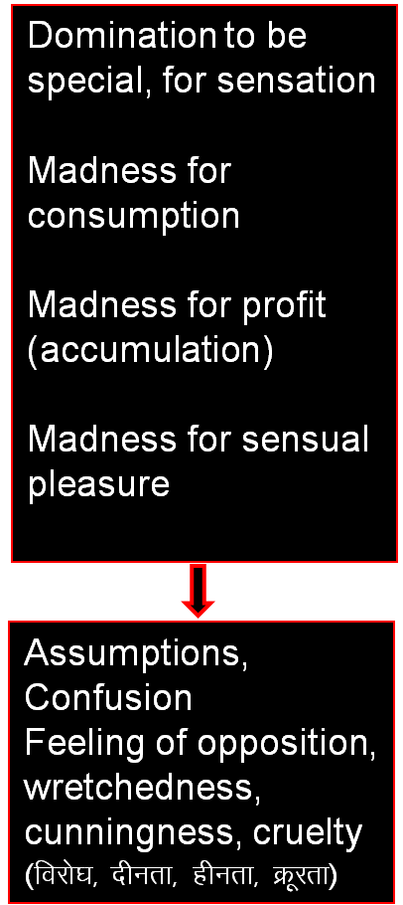
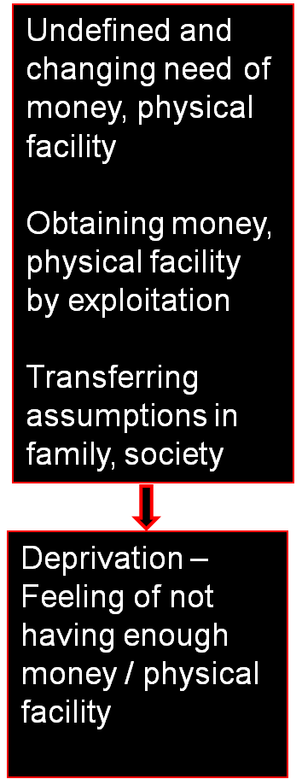
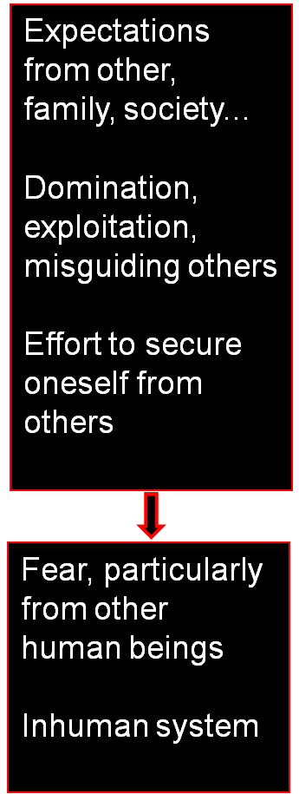
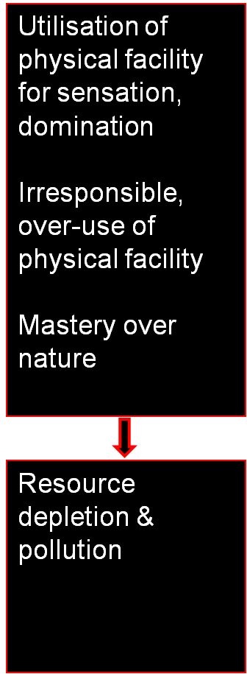
Gross Misunderstanding – Activity for Domination

Slide 38
Harmony in Society – Universal Human Order
Human Target (ekuo y{;)
Five Dimensions of Human Order ¼ekuoh; O;oLFkk & i¡kp vk;ke½
  1. Education – Sanskar - f”k{kk laLdkj
  2. Health – Sanyam - LokLF; la;e
  3. Production – Work - mRiknu dk;Z
  4. Justice – Suraksha - U;k; lqj{kk
  5. Exchange – Storage - fofue; dks’k
Ten Steps ¼nl lksiku½ – From Family Order to World Family Order
Family – Family cluster – Village – Village cluster ... Nation ... World Family
~10¹ ~10² ~10¹⁰
Right Understanding & Right Feelings
Prosperity
Fearlessness
(Trust)
Co-Existence
In Every Individual
In Every Family
In Society
In Nature/ Existence

Slide 39
Sum Up
Harmony in Society – a society in which Human target is fulfilled
– from family order to world family order
– generation after generation

Slide 40
Next we want to explore Nature/Existence
So far we have understood our Natural Acceptance
Our Natural Acceptance is for living in Harmony – as an Individual, as a Family, as a Society…
Is there provision in Nature/Existence for living in accordance with our Natural Acceptance?
Is it possible to live in harmony as an Individual, as a Family, as a Society…?
Is co-existence, mutual fulfillment inherent in Nature?
Or
Is the design of nature/existence by way of opposition, struggle, survival of the fittest…?
We will explore the underlying design of Nature/Existence with these questions…

Slide 41
Harmony in the Society
Education-Sanskar

Slide 42
Self-Discipline, Self-Confidence Lovuq'kklu] vkRefo”okl
Every child wants to understand what is right, wants to do what is right, can understand what is right
The child has the need & willingness to know, right upto the whole existence (we are not creating that need, it is innate)
The child starts with the assumption that you know, what you say is right and what you do is right… therefore he will copy everything from you
Imitate vuqlj.k (0-3)
Family
ifjokj
Follow vuqdj.k (3-6)

Slide 43
Imitate & Follow vuqlju] vuqdju
Language – words describing about 5000 real things
Accent, Mannerism…
What is important – sensation, physical facility, feeling in relationship, understanding… discussion, debate, collaboration, domination, collective decision-making, orders from someone… encourage to be responsible, collaborate or manmani, domination, separation… to be special or to be excellent… When to ask questions and when not to…
(and what is not so important, inspite of the words)
The child is a copy or reflection of the parents (sanskar)
Assuming ekuuk
Imitate vuqlj.k (0-3)
Family
ifjokj
Follow vuqdj.k (3-6)
Obedience/Discipline
vkKkikyu@vuq'kklu (5-9)

Slide 44
Self-Discipline, Self-Confidence Lovuq'kklu] vkRefo”okl
Assuming ekuuk
Knowing
tkuuk
Imitate vuqlj.k (0-3)
Family
ifjokj
School
fo|ky;
University
fo”o
fo|ky;
Society
lekt
Follow vuqdj.k (3-6)
Obedience/Discipline
vkKkikyu@vuq'kklu (5-9)
Right
lgh
Wrong
xyr
Validate
Tkkap
Self Discipline (10…)
Lovuq'kklu
Self-confidence
vkRefo”okl

Slide 45
Self-Discipline, Self-Confidence Lovuq'kklu] vkRefo”okl
Assuming ekuuk
Knowing
tkuuk
Imitate vuqlj.k (0-3)
Family
ifjokj
School
fo|ky;
University
fo”o
fo|ky;
Society
lekt
Follow vuqdj.k (3-6)
Next Generation
Obedience/Discipline
vkKkikyu@vuq'kklu (5-9)
Right
lgh
Wrong
xyr
Validate
Tkkap
Self Discipline (10…)
Lovuq'kklu
Self-confidence
vkRefo”okl

Slide 46
Self-Discipline, Self-Confidence Lovuq'kklu] vkRefo”okl
Assuming ekuuk
Knowing
tkuuk
Imitate vuqlj.k (0-3)
Family
ifjokj
School
fo|ky;
University
fo”o
fo|ky;
Society
lekt
Follow vuqdj.k (3-6)
Obedience/Discipline
vkKkikyu@vuq'kklu (5-9)
Right
lgh
Domination
'kklu
Validate
Tkkap
Wrong
xyr
Selfcenteredness euekuh

Slide 47
Self-Discipline, Self-Confidence Lovuq'kklu] vkRefo”okl
Assuming ekuuk
Knowing
tkuuk
Imitate vuqlj.k (0-3)
Family
ifjokj
School
fo|ky;
University
fo”o
fo|ky;
Society
lekt
Follow vuqdj.k (3-6)
Obedience/Discipline
vkKkikyu@vuq'kklu (5-9)
Right
lgh
Domination
'kklu
Validate
Tkkap
Wrong
xyr
Selfcenteredness euekuh
Opposition nz®g (8-12)
Revolt fonz®g (13-18)
Struggle laÄ‘kZ (18-30)
War ;q) (30…)

Slide 48
Self-Discipline, Self-Confidence Lovuq'kklu] vkRefo”okl
Assuming ekuuk
Knowing
tkuuk
Imitate vuqlj.k (0-3)
Family
ifjokj
School
fo|ky;
University
fo”o
fo|ky;
Society
lekt
Follow vuqdj.k (3-6)
Next Generation
Obedience/Discipline
vkKkikyu@vuq'kklu (5-9)
Right
lgh
Domination
'kklu
Validate
Tkkap
Wrong
xyr
Selfcenteredness euekuh
Opposition nz®g (8-12)
Revolt fonz®g (13-18)
Struggle laÄ‘kZ (18-30)
War ;q) (30…)

Slide 49
Self-Discipline, Self-Confidence Lovuq'kklu] vkRefo”okl
Assuming ekuuk
Knowing
tkuuk
Imitate vuqlj.k (0-3)
Human
Education-sanskar
ekuoh;
f”k{kk-laLdkj
Family
ifjokj
School
fo|ky;
University
fo”o
fo|ky;
Society
lekt
Follow vuqdj.k (3-6)
Obedience/Discipline
vkKkikyu@vuq'kklu (5-9)
Relationship
laca?k
Right
lgh
Domination
'kklu
Validate
Tkkap
Wrong
xyr
Selfcenteredness euekuh
Self Discipline (10…)
Lovuq'kklu
Self-confidence
vkRefo”okl
Opposition nz®g (8-12)
Revolt fonz®g (13-18)
Struggle laÄ‘kZ (18-30)
War ;q) (30…)

Slide 50
Lack of Right Understanding
Lack of Right Feelings in Oneself
    Lack of Trust
    Lack of Respect
    Lack of Affection
For a long time
Jelousy }s"k
Opposition nz®g (8-12)
Revolt fonz®g (13-18)
Struggle laÄ‘kZ (18-30)
War ;q) (30…)

Slide 51
Teacher-Student Relationship
Teacher
Feeling of Trust, Respect, Affection, Care & Guidance for the Student
Having Excellence /
Making effort for Excellence
Excellence ¼Js’Brk½
Understanding Harmony &
Living in Harmony
Student
Feeling of Trust, Respect, Affection, Reverence, Glory & Gratitude for the Teacher
Inspired by the Teacher
Making effort for Excellence
at all 4 levels
  In the Self, as an Individual
  In Family
  In Society
  In Nature/Existence

Slide 52
Definite, Ethical Human Conduct (Nischit Manaviya Acharan)
Human Values – Understanding of "What to do as a human being"
[At the level of Realisation, Understanding, Contemplation]
Policy – Detail of "how to do"Human C
[At the level of Feeling, Thought]
Character – Expression outside
[At the level of Behaviour, Work & Participation in Larger Order]
DEFINITE
Intact, Invariant, Universal
e.g. 1 – Nurturing Body
2 – Respect
SCOPE FOR CREATIVITY
Local conditions, customs, language…
e.g. 1 – Wheat, Rice, Maize…
2 – Touching feet, shaking hands…

Slide 53
Harmony in Society – Universal Human Order
Human Target (ekuo y{;)
Five Dimensions of Human Order ¼ekuoh; O;oLFkk & i¡kp vk;ke½
  1. Education – Sanskar - f”k{kk laLdkj
  2. Health – Sanyam - LokLF; la;e
  3. Production – Work - mRiknu dk;Z
  4. Justice – Suraksha - U;k; lqj{kk
  5. Exchange – Storage - fofue; dks’k
Ten Steps ¼nl lksiku½ – From Family Order to World Family Order
Family – Family cluster – Village – Village cluster ... Nation ... World Family
~10¹ ~10² ~10¹⁰
Right Understanding & Right Feelings
Prosperity
Fearlessness
(Trust)
Co-Existence
In Every Individual
In Every Family
In Society
In Nature/ Existence

